Slide 1
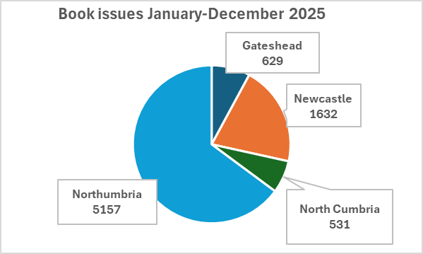
Progress, celebrations and successes - 2025
Education and Training Board Report
Digital progress
Launch of new library management system – KOHA across the northeast. Northumbria staff have been key to the success of this project working in partnership with colleagues across the region, the national team & the supplier.
Repository – embedded showcase for Trust research.
Support our Patients & People
Libby – in partnership with Bright Charity an ebook & audio book offer to all Trust staff & students focusing on fiction & HWB.
Book Club & Reading Groups – the Northumbria Book Club continues to be successful in encouraging reading across the Trust & attracting new user groups & several reading groups plus multiple copies of books which we share with other NE Trusts.
Patient library boxes at all sites for loan to wards.
Innovate & continuously improve
Pop-up libraries – now established at Cobalt & The Hub.
Grow our own & keep them
2 x Band 4/5 Development Posts created with staff developing through a career plan from Band 3 to band 5 professional role.
Professional area
Library & Knowledge Services – Jackie McGuire
LKS - Annual Report
2025/2026
Key Metrics
Libby – 1803 checkouts by 285 users (67% audio/ 33% ebooks)
Repository - 141 records added
45 literature searches
Clinical Guidelines – 60 ratified; guidelines downloaded a total of 136302 times
Training/Induction – 108 session with 1249 staff/students attending
2026 impact survey
Service improvement plan - 2026
New
Submission of Quality Improvement Framework accreditation documentation and review–June 2026.
Libby - Research demand and options for non-fiction ebooks on Libby e.g. leadership & coaching.
Clinical Guidelines – proposed move to EOLAS and scoping of Alliance working/sharing.
Pilot new apprenticeship for library assistants as part of developing staff for the future.
Continual development
Increase number of users and usage through promotion including clinical decision tools & literature searching
Koha – embed system including inter-library loan functionality
Improve training offer focusing on broadening online resources and access.
Explore hosting Improvement and Trust Conference Posters to further capture institutional knowledge in the Repository.
Strengthen collaboration between Trusts in the north-east to meet the library and knowledge services needs of staff & students
Improve current awareness offer clinical and non-clinical staff
Summary – an exciting year, full of innovation, change & growth!
Our first full year at the Health & Care Academy working with new staff groups more closely and a focus on academic skills training as well as the “traditional” library service offer.
Growth in many areas remains with an increase of library users, books loaned, clinical guidelines accessed and more staff and students attending inductions and training.

